Slide 1
SOAP and RESTful Architecture
Dr. Bhawana Rudra

Slide 2
There are two core web service architecture strategies:
Simple Object Access Protocol (SOAP)
REpresentational State Transfer (REST)

Slide 3
What is SOAP?
SOAP (Simple Object Access Protocol) is its own protocol and is a bit more complex by defining more standards than REST—things like security and how messages are sent.
These built-in standards do carry a bit more overhead. Still, they can be a deciding factor for organizations that require more comprehensive features in the way of security, transactions, and ACID (Atomicity, Consistency, Isolation, Durability) compliance.
For the sake of this comparison, we should point out that many of the reasons why SOAP is a good choice rarely apply to web services scenarios, which makes it more ideal for enterprise-type situations.

Slide 4
Reasons you may want to develop an application with a SOAP API include higher levels of security (e.g., a mobile application interfacing with a bank), messaging apps that need reliable communication, communicating with legacy systems, or ACID compliance.
SOAP has much tighter security. In addition to SSL support, WS-Security is a built-in standard that gives SOAP some more enterprise-level security features if you require them.
Successful/retry logic for reliable messaging functionality. REST doesn’t have a standard messaging system and can only address communication failures by retrying. SOAP has successful/retry logic built-in and provides end-to-end reliability even through SOAP intermediaries.
SOAP has built-in ACID compliance. ACID compliance reduces anomalies and protects the integrity of a database by prescribing how transactions can interact with the database. ACID is more conservative than other data consistency models, which is why it’s typically favored when handling financial or otherwise sensitive transactions.

Slide 5
Common web service specifications include:
Web services security (WS-security): Standardizes how messages are secured and transferred through unique identifiers called tokens.
WS-ReliableMessaging: Standardizes error handling between messages transferred across unreliable IT infrastructure.
Web services addressing (WS-addressing): Packages routing information as metadata within SOAP headers, instead of maintaining such information deeper within the network.
Web services description language (WSDL): Describes what a web service does, and where that service begins and ends.

Slide 6
What is REST
Its principles were formulated in 2000 by computer scientist Roy Fielding and gained popularity as a scalable and flexible alternative to older methods of machine-to-machine communication.
It still remains the gold standard for public APIs.

Slide 7
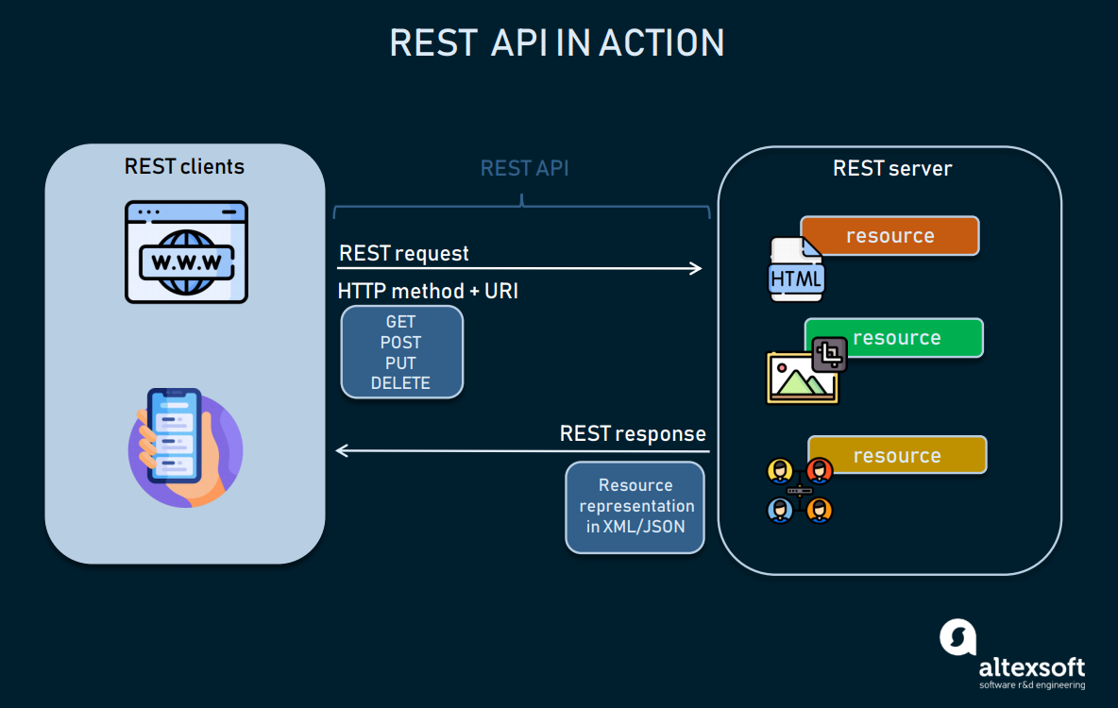

Slide 8
What is a rest API?
REST (Representational State Transfer) is truly a “web services” API.
REST APIs are based on URIs (Uniform Resource Identifier, of which a URL is a specific type) and the HTTP protocol and use JSON for a data format, which is super browser-compatible.
REST APIs can be simple to build and scale, but they can also be massive and complicated—it’s all in how they’re built, added on to, and what they’re designed to do.

Slide 9
Reasons you may want to build an API to be RESTful include resource limitations, fewer security requirements, browser client compatibility, discoverability, data health, and scalability—things that really apply to web services.
Some quick REST information:
REST is all about simplicity, thanks to HTTP protocols.
REST APIs facilitate client-server communications and architectures. If it’s RESTful, it’s built on this client-server principle, with round trips between the two passing payloads of information.
REST APIs use a single uniform interface. This simplifies how applications interact with the API by requiring they all interface in the same way, through the same portal. This has advantages and disadvantages; check with your developer to see if this will affect implementation changes down the road.
REST is optimized for the web. Using JSON as its data format makes it compatible with browsers.‍
REST is known for excellent performance and scalability. But, like any technology, it can get bogged down or bog down your app. That’s why languages like GraphQL have come along to address problems even REST can’t solve.

Slide 10
An application is said to be RESTful if it follows 6 architectural guidelines. A RESTful application must have:
A client-server architecture composed of clients, servers, and resources.
Stateless client-server communication, meaning no client content is stored on the server between requests. Information about the session’s state is instead held with the client.
Cacheable data to eliminate the need for some client-server interactions.
A uniform interface between components so that information is transferred in a standardized form instead of specific to an application’s needs. This is described by Roy Fielding, the originator of REST, as “the central feature that distinguishes the REST architectural style from other network-based styles.”
A layered system constraint, where client-server interactions can be mediated by hierarchical layers.
Code on demand, allowing servers to extend the functionality of a client by transferring executable code (though also reducing visibility, making this an optional guideline).

Slide 11
SOAP vs. REST: The key differences
SOAP is a protocol, whereas REST is an architectural style
REST APIs access a resource for data (a URI); SOAP APIs perform an operation
Security is handled differently
SOAP requires more bandwidth, whereas REST requires fewer resources (depending on the API)

Slide 12
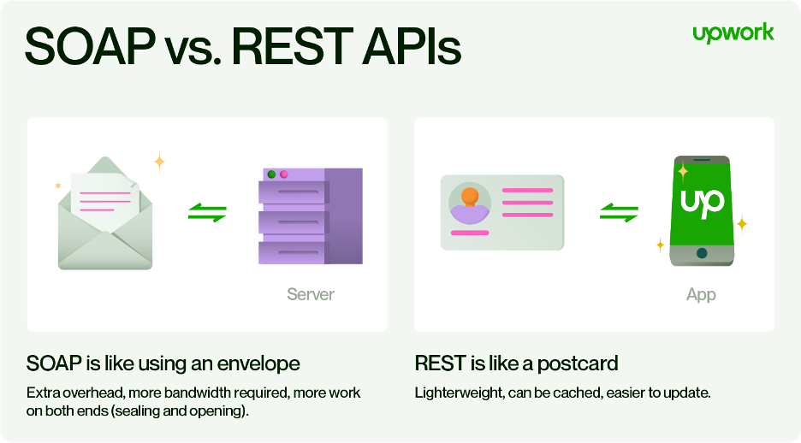

Slide 13
REST calls can be cached, while SOAP-based calls cannot be cached
APIs are built to handle your app’s payload, and REST and SOAP do this differently

Slide 14
SOAP and REST Alternatives
JSON
gRPC
GraphQL

